Slide 1

Intro to HTML

Slide 2
Question
How are web pages made??

Slide 3
HTML
HTML is the language for building web pages!

Slide 4
Why HTML?
HTML lets us build our own web pages

Slide 5
Why HTML?
Web pages allow us to easily share our ideas and creations with the world!

Slide 6
Why HTML?
Facebook

Slide 7
Why HTML?
Facebook
Google

Slide 8
Why HTML?
Facebook
Google
CodeHS

Slide 9
Why HTML?
Facebook
Google
CodeHS
Every web page on the internet

Slide 10
Why HTML?
Facebook
Google
CodeHS
Every web page on the internet
All built with HTML

Slide 11
Why HTML?
Facebook
Google
CodeHS
Every web page on the internet
All built with HTML
By people who learned HTML!

Slide 12


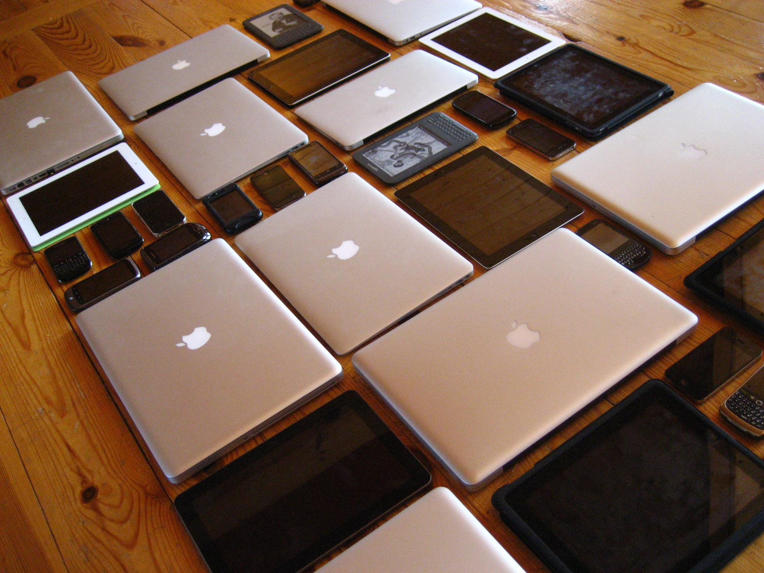
Why HTML?
<html>
__
___
______
__
_____
</html>
yourWebpage.html
ANY browser on ANY device
Beautiful Webpage!

Slide 13
Why HTML?
<html>
__
___
______
__
_____
</html>
yourWebpage.html
ANY browser on ANY device
Beautiful Webpage!
Notes:
Quick explanation of a “browser” for those who don’t know that term
Application on your computer that knows how to interpret these html documents and display them as the visual, audible web pages you see on the internet, including this video.

Slide 14
Why HTML?
<html>
__
___
______
__
_____
</html>
yourWebpage.html
ANY browser on ANY device
Beautiful Webpage!
Notes:
Today we’re going to learn how to make this part.

Slide 15
What is HTML
H
T
M
L

Slide 16
What is HTML
Hyper
T
M
L

Slide 17
What is HTML
Hyper
Text
M
L

Slide 18
What is HTML
Hyper
Text
Markup
L

Slide 19
What is HTML
Hyper
Text
Markup
Language

Slide 20
What is HTML
Hyper
Text
Markup
Language
HyperText - text displayed on a computer that has links to other hypertext documents (hyperlinks)

Slide 21
What is HTML
Hyper
Text
Markup
Language
HyperText - text displayed on a computer that has links to other hypertext documents (hyperlinks)
Markup Language - lets you annotate text to define how it should be displayed

Slide 22
What is HTML
So how does HTML “markup” the text of a web page?

Slide 23
HTML tags
HTML tags mark up the text of a document in order to tell the browser how the text should be displayed

Slide 24
HTML Tags
HTML is made up of tags that mark up the text of a document in order to tell the browser how the text should be displayed.

Slide 25
HTML Tags
HTML is just normal text + markup tags

Slide 26
HTML Tags
Enclosed in angle brackets: <h1>
Not displayed on the resulting web page
Inform the browser about how certain text should be displayed

Slide 27
Our First HTML Tag: h1
<h1>
Tags start and end with angle brackets

Slide 28
Our First HTML Tag: h1
<h1>
The name of the tag goes in between the angle brackets

Slide 29
Our First HTML Tag: h1
<h1>Hello!</h1>
Open tag
Close tag

Slide 30
Our First HTML Tag: h1
<h1>Hello!</h1>
Note the / on the closing tag

Slide 31
Our First HTML Tag: h1
<h1>Hello!</h1>
Content affected by the tag

Slide 32
Let’s see this in the editor!

